Slide 1
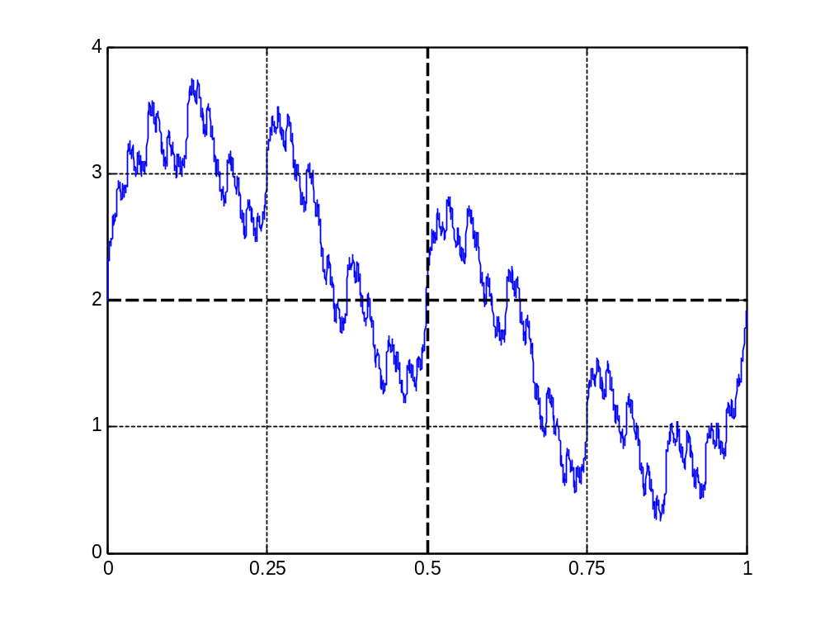
Axes(2,2)
Ratio(1)*Size(1)
Ratio(1)*Size(2)
Ratio(2)*Size(2)
Ratio(2)*Size(1)
Axes(2,1)
Axes(1,1)
Axes(1,2)

